Slide 1
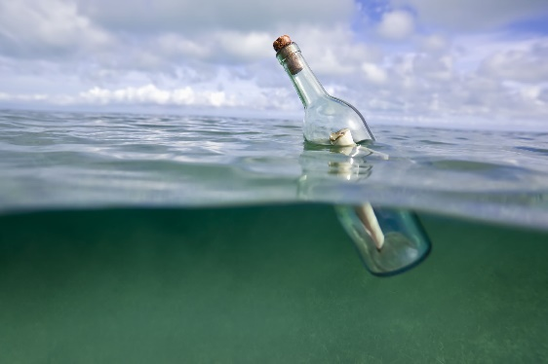



EY – IBM Sustainability Challenge
Encouraging responsible consumption and purchasing through competition and education

Slide 2


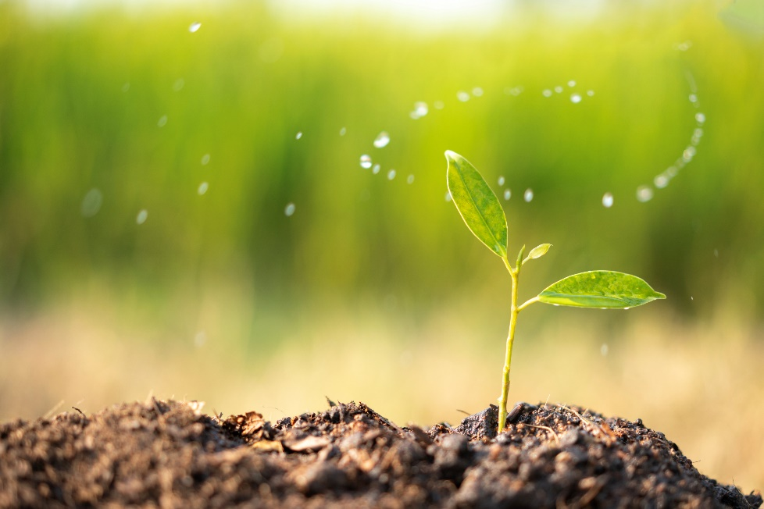


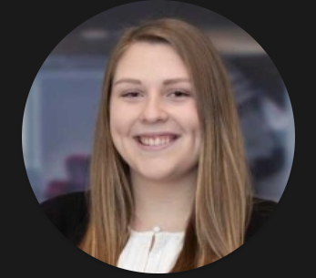
EY Team Introductions and Abstract for Recyclability!
Abstract: Responsible Consumption & Production
Sustainability Team
 | Shivraj Patil EY Senior Manager, Technology Consulting
 | Kristie Harvick EY Manager, Technology Consulting
 | Michael Cartwright EY Manager, Technology Consulting
 | Sabitha Puri EY Manager, Technology Consulting
 | Marley Waskin EY Senior, Technology Consulting
Our goal is to promote sustainable consumption through the reduction of waste and encouraging individuals to purchase eco-friendly, sustainable products.
By developing a competition-based, educational mobile application, we will encourage users to reduce recyclable waste and purchase sustainable products

Slide 3
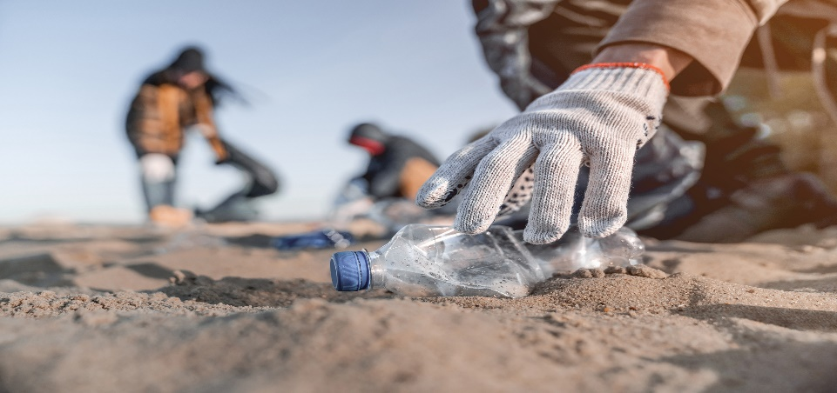
Problem Statement and Why its Important
While everyone understands the importance of recycling and how it can contribute to a sustainable society, a lack in motivation, education, and accessibility reduces the drive and practicality to do so...
What is Recycling?
Recycling is the process of collecting and processing materials that would other wise be thrown away as waste and turning the materials into new products.¹ Per the United States Environmental Protection Agency, recycling:
Reduces waste sent to landfills and incinerators
Conserves earth’s natural resources
Saves energy and reduces pollution
Creates new jobs
Why is it Important?
The U.S. recycles less than 22% of its discarded materials and generates more waste than any other country. In fact, Americans alone throw away ²:
2.5 million plastic bottles every hour ²
11 million tons of glass bottles and jars each year ³
Enough aluminum every 3 months to rebuild our entire commercial air fleet ²
Enough office paper each year to build a 12ft wall from Seattle to New York ²
How Does Recycling Help?
5 plastic bottles makes enough fiberfill to stuff a ski jacket ³
1 glass bottle saves enough energy to light a 100-watt light bulb for 4 hours ³
1 aluminum can saves enough energy to run a television or computer for 3 hours ³
20 cans can be made out of recycled materials using the same energy it takes to make one new one ³
Enough energy is saved each year by recycling steel to supply Los Angeles with electricity for almost 10 years ³
¹ https://www.epa.gov/recycle/recycling-basics
² https://www.recycleacrossamerica.org/recycling-facts
³ Recycling Facts | The Green Team

Slide 4
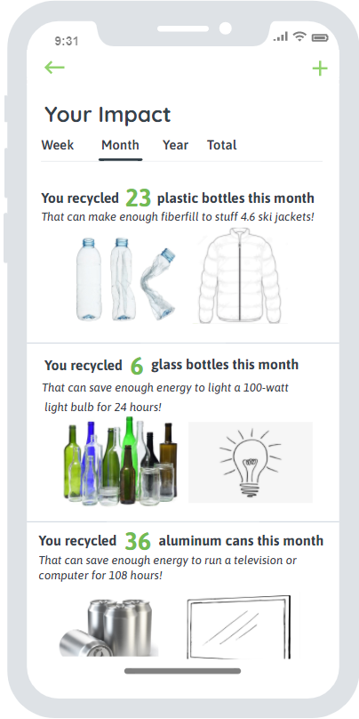
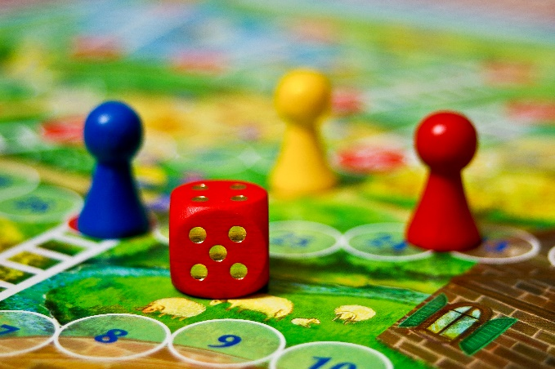
How can we help encourage recycling?
Promote through education…
The application will promote recycling education and awareness through recycling location identification and sustainability fun facts. Users will be able to identify recycling locations in all U.S. cities based on materials and distance.
The application will record the amount of materials recycled based on user input and keep a running tally to show the progress made. Information regarding the impact of the user’s recycling such as the amount of energy saved will be consolidated and reported out to promote the continuance of recycling.
Encourage through competition…
Our exciting mobile application makes recycling fun by encouraging users to adopt healthy and sustainable habits through individual or team based competition and a redeemable points reward system.
Competition:
Users will be able to compete with friends, family, colleagues, and strangers to accumulate points through recycling and demonstrate their dedication to recycling and sustainability. The application will allow users to form teams and hold sustainability challenges with points earned contributing to a redeemable point system.
Points Reward System:
Users will be able to redeem points achieved through recycling for fun and sustainable prizes such as re-usable water bottles, compost bins, produce bags, solar powered phone chargers and more!

Slide 5
Approach for Application Competition Scoring
Point System:
Users can earn points by engaging in sustainable habits that can later be redeemed for cool and sustainable rewards such as reusable water bottles, solar powered phone chargers, etc. Higher points are given to activities that have higher impact.
Recycling a can or bottle
Filling up a reusable water bottle
Recycling cardboard
Recycling large items (mattresses, tires, electronics)
Recycling paper
Signing up for e-billing
1 pt
1 pt
3 pts
10 pts
12 pts
30 pts

Slide 6
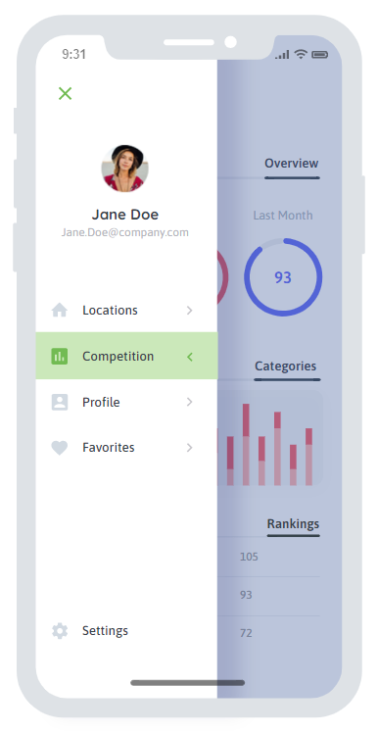
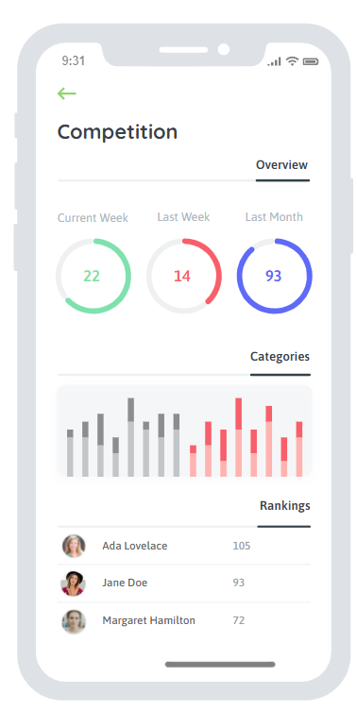
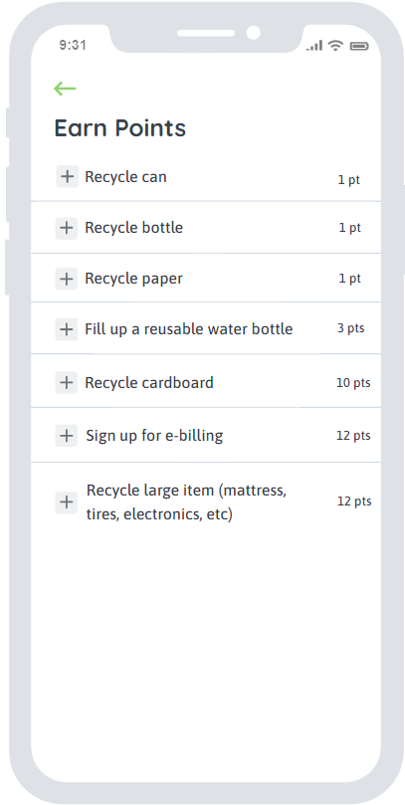
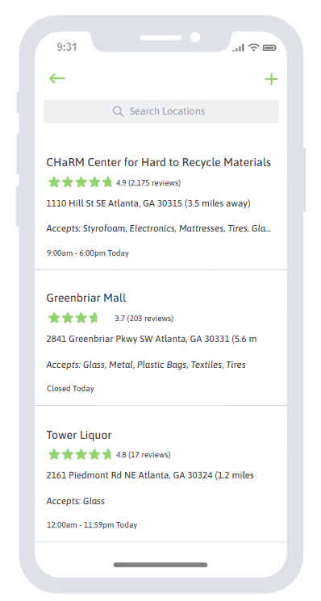
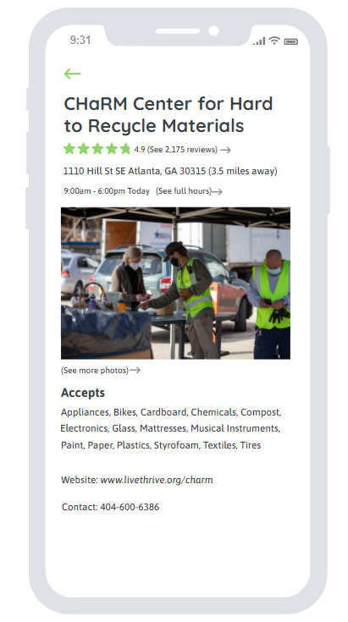
Core Application Competition & Location Functionality Mockups
The core functionality of the application consists of a competition and a location search:
With the competition functionality, the user can record their sustainable activities and view a dashboard with summaries of their activities and standings
With the location functionality, the user can search for recycling locations near them. Criteria include distance, items accepted and reviews
Competition dashboard
Record activities for competition
Search for recycling locations
View recycling location details
Menu

Slide 7
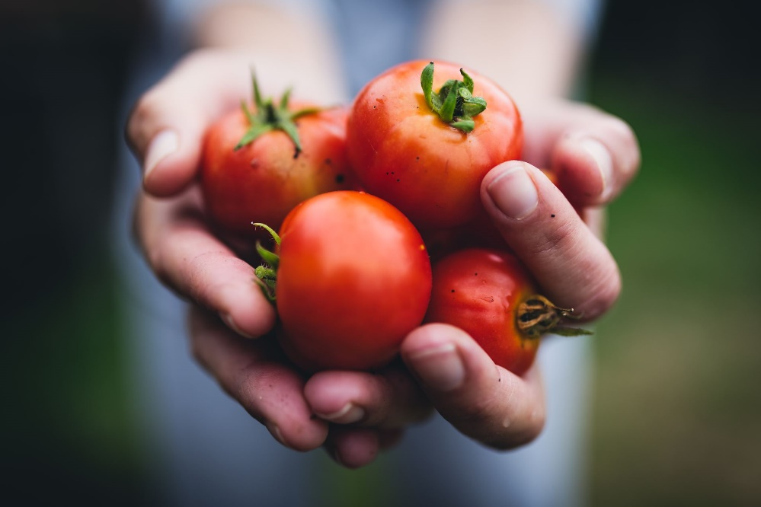
Potential Future Add-ons to Application
Food Consumption Engine
Our mobile application makes consumption responsible by helping track food items in the fridge/pantry and minimize waste. Our motto is to help you “Buy All that you can consume” with zero waste.
Product Tracking: Scan the products you buy via the bar code tracker in the app
Friendly Reminders: The Application keeps a track of the items in the fridge/pantry and sends you a reminder to consume the product before the expiry date hence minimizing wastage
Share and Care: Not going to be able to consume a product which has a close expiry date? Application can be embedded with other apps like for example Neighborhood app and list items that can be shared with the community/Neighbors to minimize wastage
Reporting: Tracks your consumption needs and reports how effectively wastage has been minimized

Slide 8
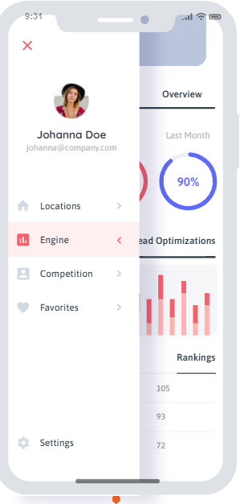
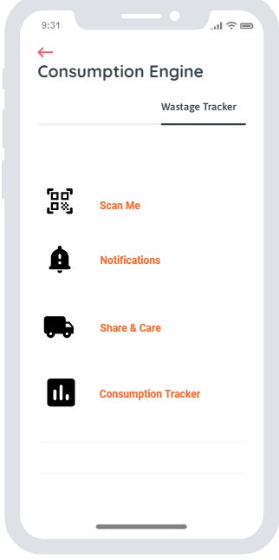
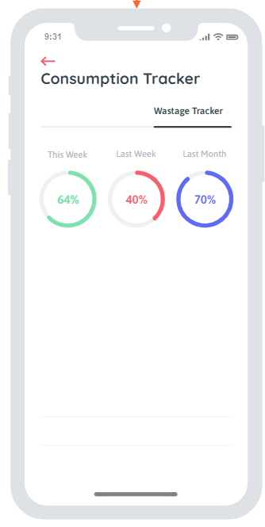
Consumption Engine Feature Mockups
The future add-on functionality of the application could consist of food waste management and include features for product tracking, notifications, and consumption reporting to encourage responsible consumption and reduce waste.
Menu
Consumption Engine
Consumption Tracker Reporting

Slide 9

Next Steps
Complete application functional design and receive feedback
Build application BETA model and perform testing
Finalize application build

